Slide 1
COP290 Assignment-2 subtask-2
Hrishabh Sangwaiya | Girvar Patidar
2022CS11625 | 2022CS11616

Slide 2
Brief Intro of our Game
It is a single-player platform game in which we need to save our protagonist from various addictive substances like smoking, alcohol and drugs.
It has been developed with Pygame, a Python library, mostly from scratch.
The basic goal of our game is to spread a
social message that consuming these addictive
substances is very lethal.

Slide 3
DESIGN CHOICES
Surprise Elements :
We’ve added various surprise elements in our game to make our game interesting and engaging for the player.
"Reality often defies appearances; what meets the eye isn't always what meets the truth.”
Alcohol can alter your body movements, which has also been shown in our game.
Music :
The game has background music and various good-quality sound effects to get a good gaming experience.

Slide 4
DESIGN CHoices
Levels :
Our game has a total of 7 levels.
At each level, we have to collect a key in order to open the door to the next level.
Health :
We’ve added a health bar shown by hearts which represents the health of our protagonist and if he’s left with no hearts, he dies.
Our health is dependent on our eating habits and lifestyle.
Consuming addictive substances decreases your health.

Slide 5
basic ORGANIZATION of our game
We have organized our game structure into various files and classes which serves different purposes and aspects of the game.
A structured code ensures that this game can be scaled with much more complexity. We laid out a basic framework to deploy this product into production.
We have made different levels files for making
all the levels customized in the way the game
was to be designed.

Slide 6
How WE MADE OUR GAMEMAP?
We have used the Tiled software, designed for for crafting game maps, to construct our maps, saved in the .tmx format.
We used simple and classic tiles to make our game look classic and not much fancy as our social issue demanded.
We used pytmx python package in order to import the tmx data of our map.

Slide 7
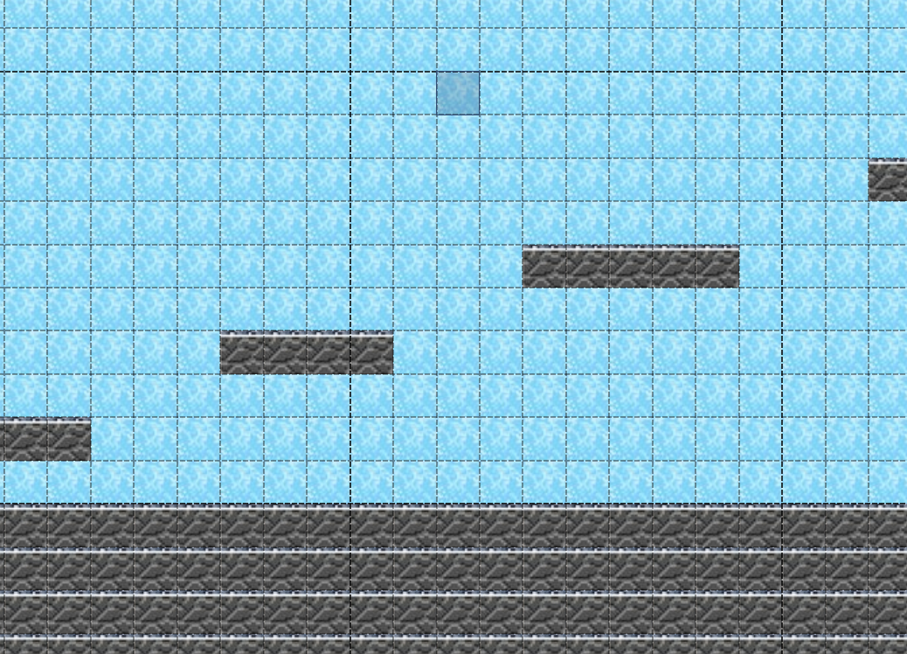
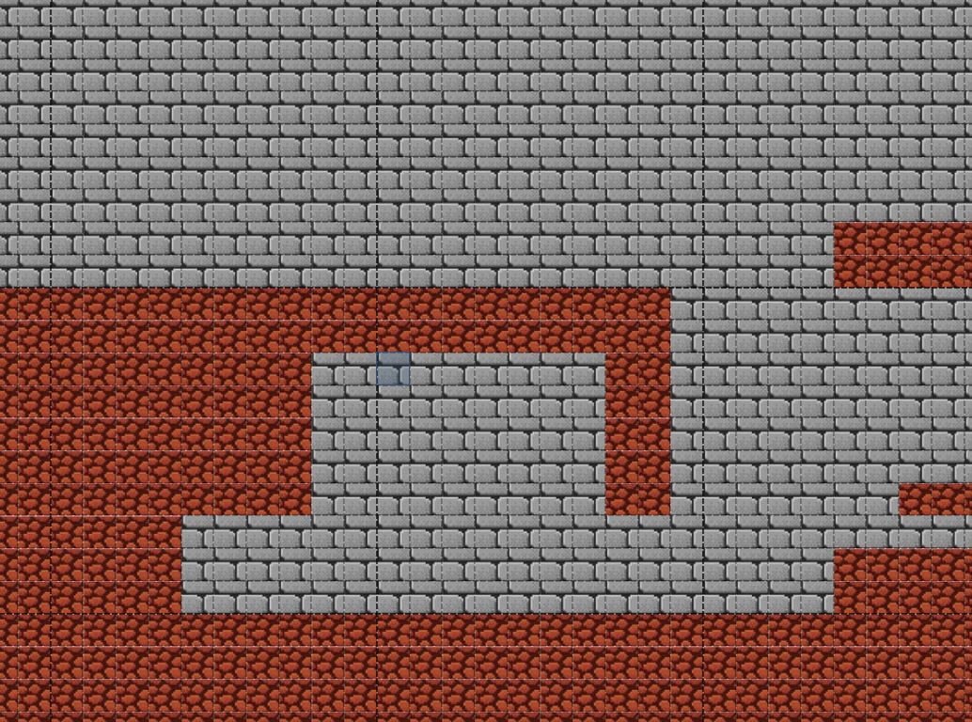
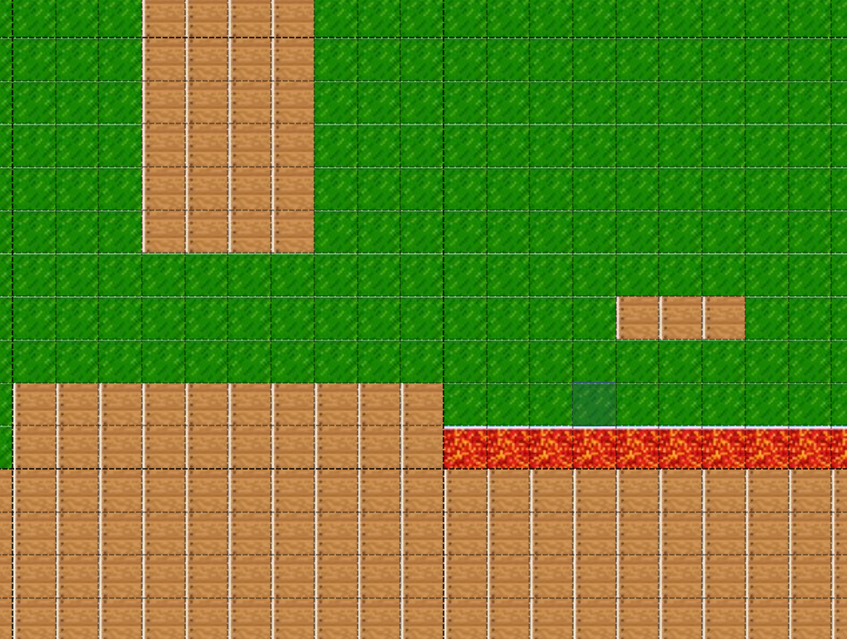
HoW WE MADE OUR GAMEMAP?
The 3 types of maps that we designed:

Slide 8
How WE MADE OUR CAMERA?
In pygame, the concept of a camera isn't present. Therefore, rather than directly moving the player, we opted to move all other sprites, including the player.
The absence of a dedicated camera implementation in pygame is compensated by utilizing screen offsets.
These offsets are dynamically adjusted to maintain the player character at the center of the screen while completing the levels.

Slide 9
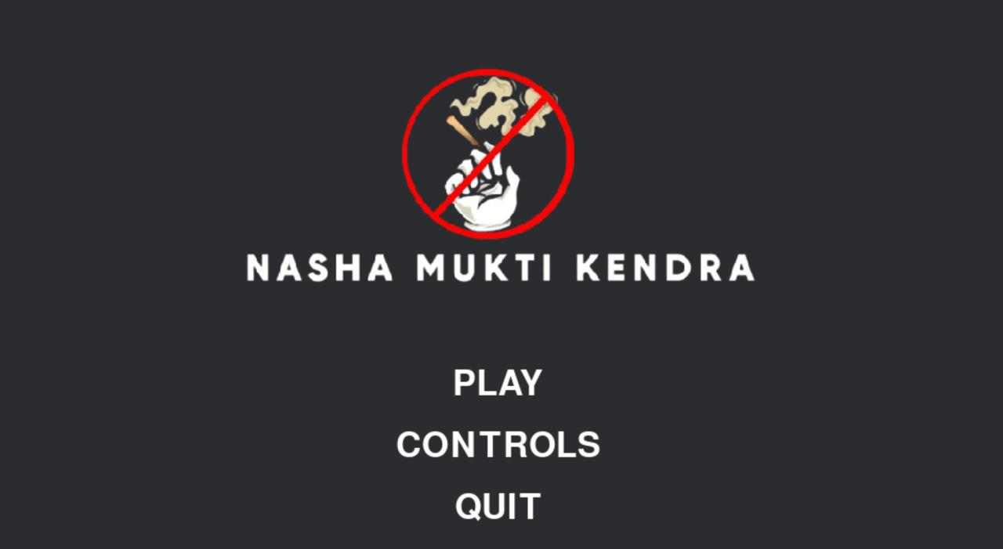
User Interface
Our game our various UI elements like buttons, Main Menu, GameOver screen, etc.

Slide 10
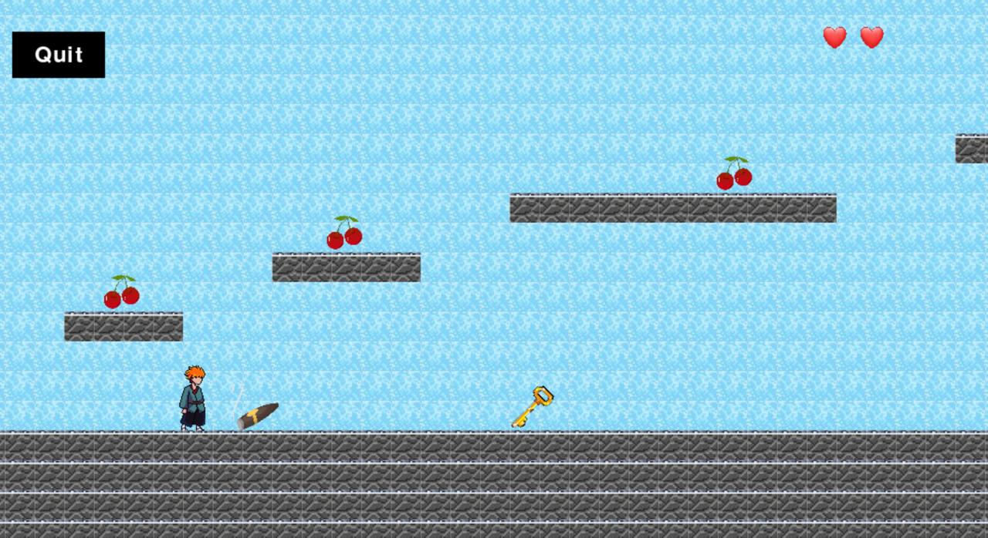
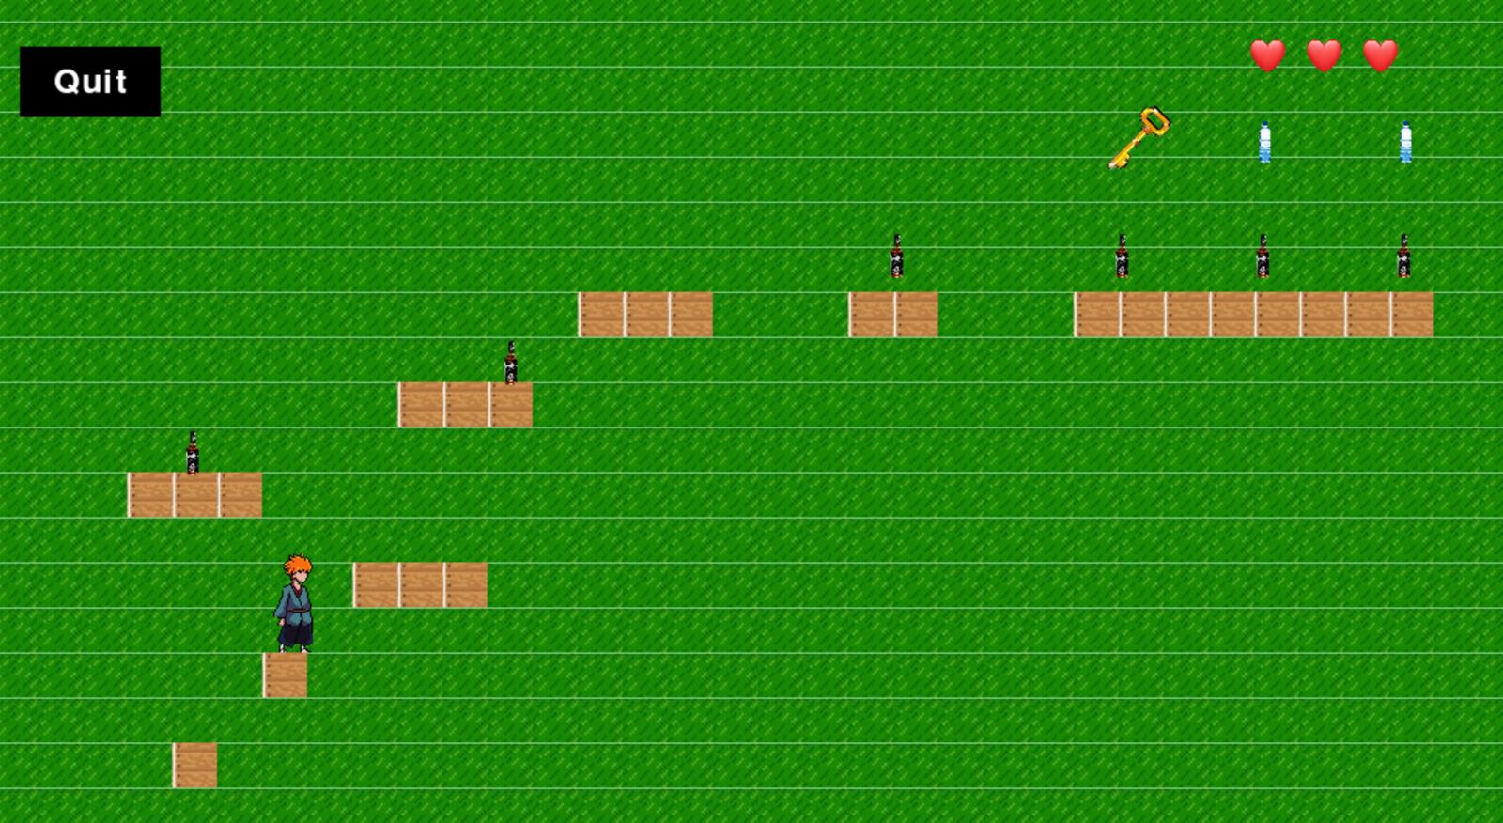
UI and overlay screenshots

Slide 11
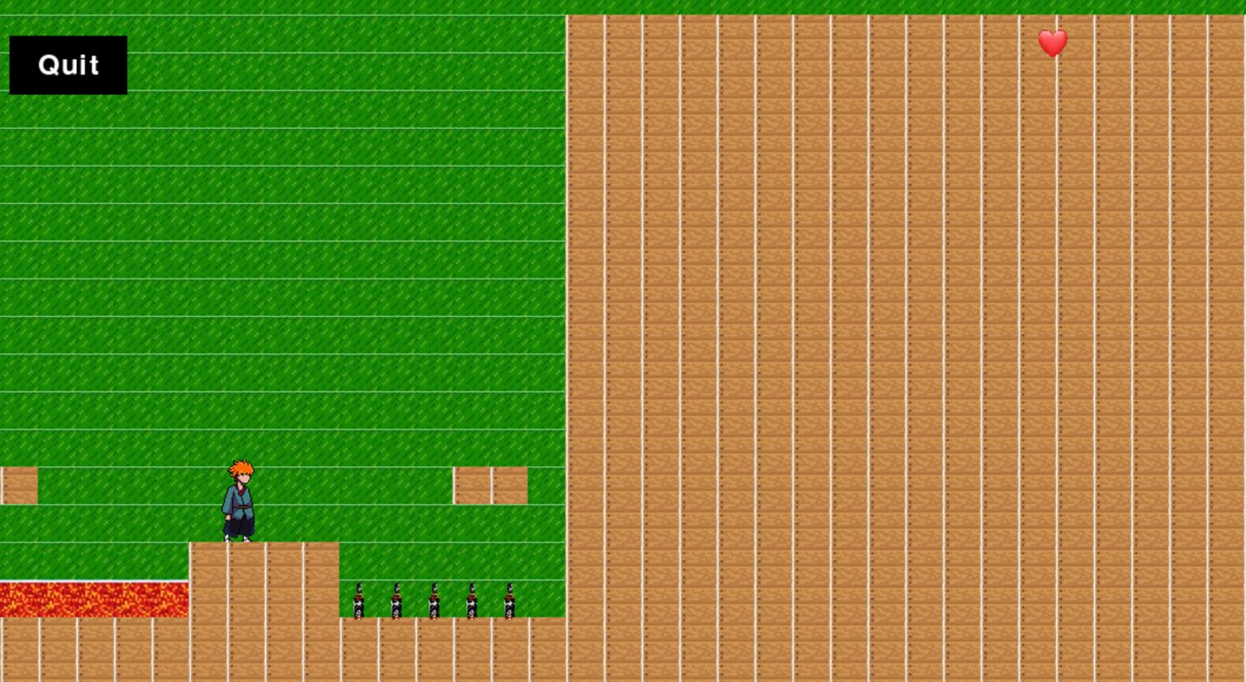
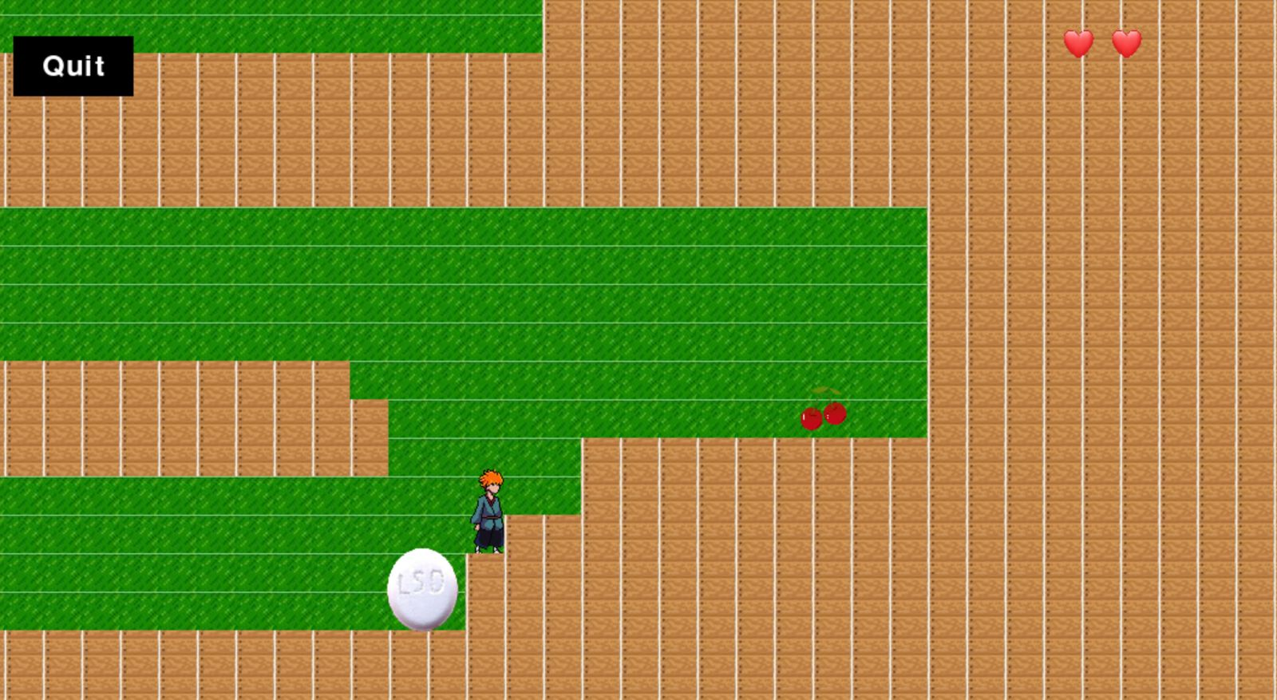
UI and overlay screenshots

Slide 12
cODE structure
The main.py file is the basic controller of the game. It controls which levels are currently unlocked and which level will run next.
The home screen and level screens are also controlled by this main file.
The player.py file contains the class of our protagonist which contains all the attributes of the player like health, position, etc.

Slide 13
CODE STRUCTURE
There are 7 level files ( THALA for a reason ).
Each level has 3 screens. The first or opening screen contains basic understanding of the level and the social message we’re trying to address.
The second screen contains the game level, which the player enjoys. It contains various objects and sprites of our level in the play function which is being called by the main file.
Object & player movement and collision algorithms are also defined in the level files.

